Slide 1

WAIŪ– A Celebration Of Sharing Happiness

Slide 2








WAIŪ : Mission, Vision & Values
Mission:
To create a global entrepreneur of hospitality industry, realizing pioneering advancements in established services and accomplish mutual growth for both our partners & customers
Vision:
WAIŪ is dedicated to provide modern & innovative solutions to our hospitality partners, via introduction of technology evolution in their offerings and opening avenues of inspiring new business horizons.
Values:
Innovation through Leadership : To spearhead hospitality experience enrichment, consistently
Modernization & Elegance : To develop ultramodern hospitality business solutions
Focus & Evolution : Relentlessly strive to improve business value through performance

Slide 3
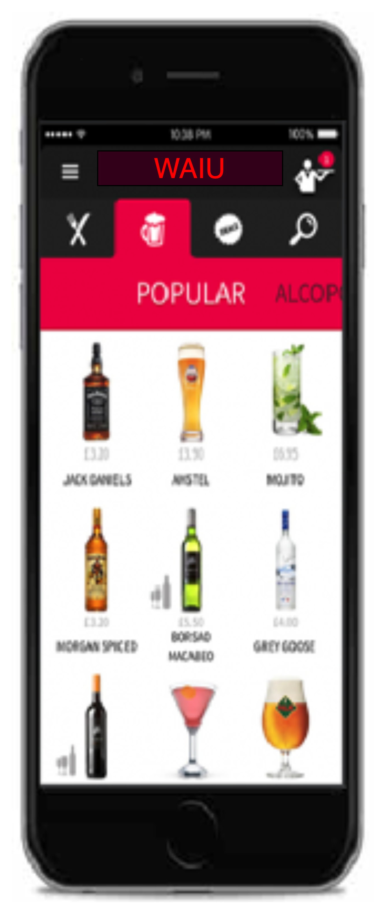








Product & Features
F&B Services
Instant cashback facility for regular customers to avail restaurant services
Broadcast & Live Streaming
Watch live shows & virtually share special moments with the dear ones & staff training demonstrations
Gift a Friend
Gift or share an item of choice to your beloved ones – Family & Friends, Colleagues, Corporates
Clique - Eat Now, Pay Later
Privileged services for the our NBFC/MFI partner customers
Offer a New Friend
Offer service will be availed at merchant establishment with other groups or individuals
Events & Gaming
Promote corporate events, interactive games for in-house patrons
Payments & PBS
Express true feeling of sharing & gifting with points instead of money
Logistics & Governance
Reduced expenses through aggregator independence, merchant governance support

Slide 4
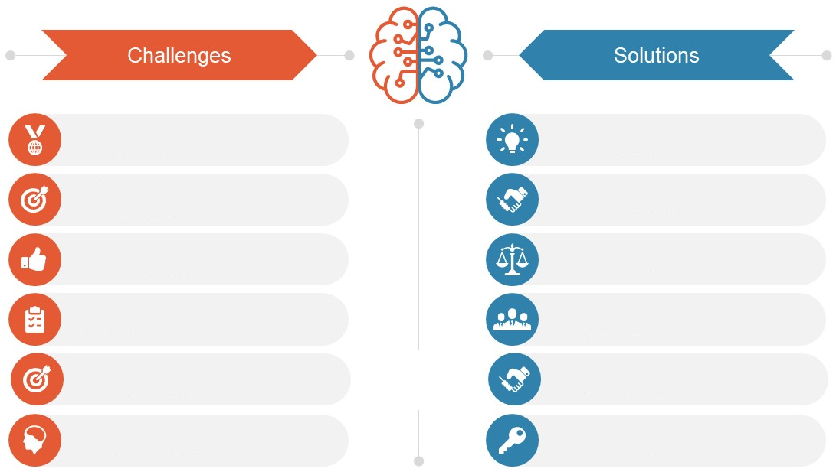
Industry Challenges & Solutions
Lack of options to share or gift F&B service to friends & family
Unique & unmatched opportunity
to share/offer F&B item to anyone
No socializing platforms in restaurant premises
Innovative technology driven platform for B2C & C2C interaction
Low margins of operation when utilizing traditional delivery models
Higher benefits & financial control with reduced expenses
No avenues for cost effective event arrangement or governance
Impactful means of event
organization & rapid marketing
Menu pricing obligation without future benefits
Guaranteed cashback, exciting offers, free & credit services
No tangible advantages of higher spend & lockdown sensitivities
More value for money via PBS, M&E features, networking, memberships

Slide 5
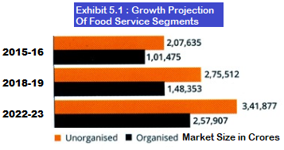
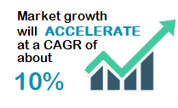
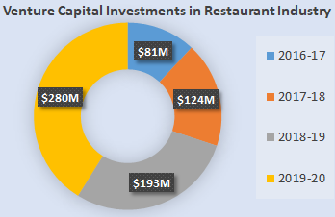
Market Research Convergence
Source: NRAI & FICCI / PwC, World Bank
Trend #1: Ethnic cuisine will increasingly be present in organized and hygienic set-ups
Trend #2: Food tech will continue to ‘organize’, driving increased focus on consumers, innovation & efficiency
Trend #3: Restaurants will increasingly focus on consumer engagement using technology
Trend #4: Health and wellness will continue to ride high on consumer preferences
Trend #5: Traditional packaging will make way for innovative food packaging
Trend #6: FMCG & entertainment industries will be major beneficiaries of rising disposable income

Slide 6



Clique – The Opportunity
Clique is premium service offered to our finest customers & business partners, to mutually benefit from each other through microfinancing services.
Clique will be a unique solution focused on hospitality industry, which has been consistently growing & creating pristine opportunities for restaurants & it growing youthful consumer base.
Clique is designed to promote inclusive growth in hospitality industry by introducing flexible borrowing as channel partners, while simultaneously allowing ease of doing business and comfortable provisions.
With microfinance market anticipated to grow with CAGR of 40% through 2025, NBFC-MFIs will be its greatest beneficiaries. In F&B segment, unbanked microlending has only reached 12-15% of the prospective market.

Slide 7
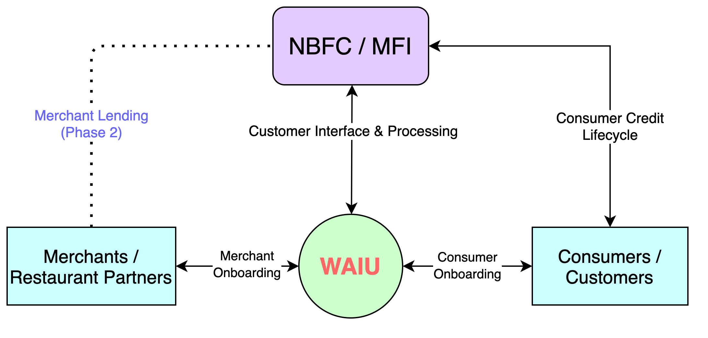
Clique – Lending Services
CASE STUDIES
Zomato, in partnership with InCred, to lend Rs 1L to 50k restaurants, developing loan book of 500CR
PAYO (Australia) – Launched ENPL service in July-21 & already has 500+ restaurant partners

Slide 8
Clique – 360° Benefits
Eat now, Pay Later
Consumers | Restaurants | MFI-NBFC
Increase in spend potential | Increased sales | New customers
Bio-authorization to reduce risks | Higher ticket size | Increased presence
No joining or renewal fees | New feature to offer | Competitive edge
Decorum & savings | No additional charges | Innovative offer
Microfinancing
Consumers | Restaurants | MFI-NBFC
Increased borrowing potential | Self-sufficiency at competitive rates | Untapped market – Millennials, Zoomers
Enhanced financial literacy | Standardized & organized system | Inclusive growth
Reactive credit scoring | Reduced regulatory challenges | Valued partnership
Better rates than banks | Co-branding opportunities | Benefit from geographic expansions

Slide 9
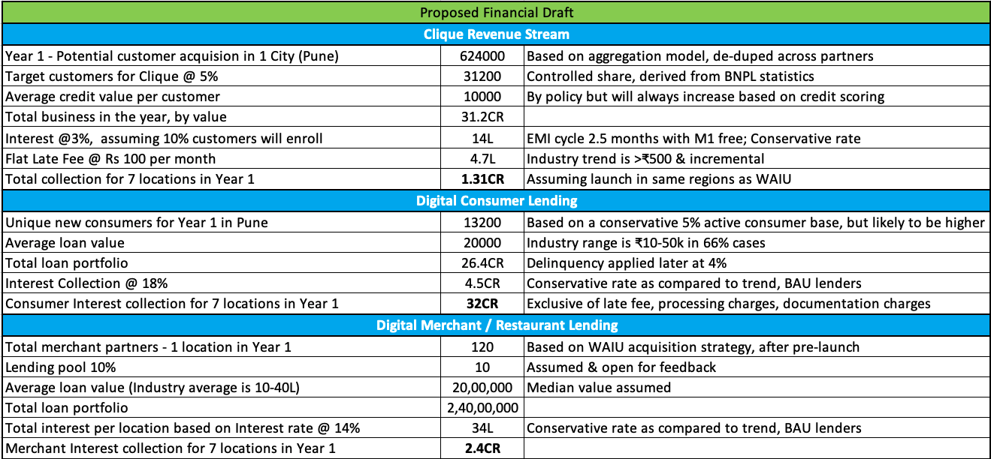
Clique – Commercials

Slide 10
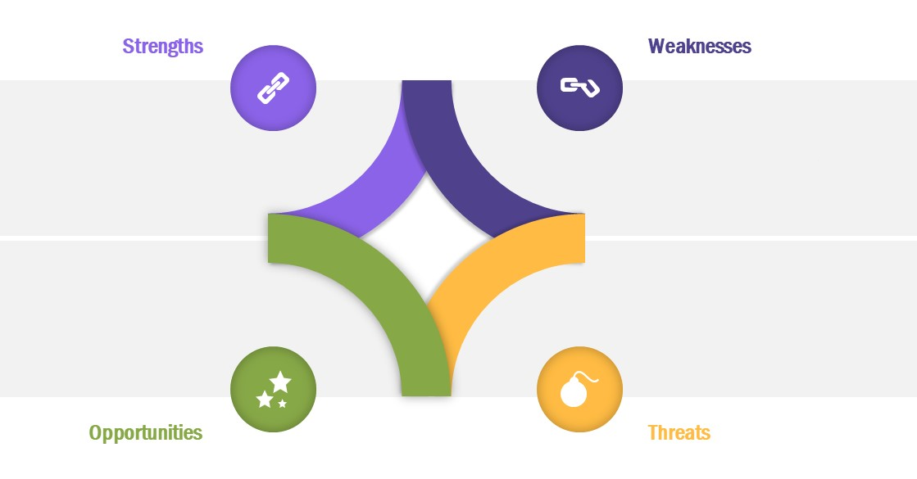
SWOT Appraisal
Unique service offerings
Cross-industry appeal e.g., Banking, M&E
Digital marketing enabler
Added value of money for customers
Brand Establishment
Cross-Industry partnerships
Absence of support from Venture Capital or Institutional Investors
First mover’s advantage
Rising disposable income
Technology innovation & influence
Unorganized sector standardization
Rising urbanization
International tie-ups
Expansion of existing service aggregators into hospitality business
Competition from global players
If we wont do it, someone else will

Slide 11





Value Proposition
New & relevant consumer base
Gift / Offer a Friend
Increased Digital Reach Through Acceptance & Branding
Bonus Media & Entertainment
Interactive Games & Entertainment
Higher Customer Retention
Enhanced Restaurant Search & Selection
Reduced Operating Costs
& Cross-Industry Marketing Network
Cost Effective Marketing
Socializing Channel
Corporate Events & Flexible Packaging for Social Occasions
Standard Multi City Platform
Indirect Revenue Source
Economical Delivery
Event Registration & Livestreaming

Slide 12
Customer Acquisition Strategy
Merchant Acquisition Strategy | Consumer Acquisition Strategy | Notes
Direct sales via dedicated regional teams (10 per location per month) | WAIU direct acquisition (6-8k per location per month) | WAIU service acquisitions
Corporate collaborations with multi-location hospitality brands | Aggregation based model to increase time to market | To enable increased time to market
Pre-launch promotional & marketing campaigns | Social media & network advertisements | Combination of digital & traditional strategies
Network tie-ups and contact center | Event tie-ups e.g., Ridermania, Ruggedian

Slide 13

Minimum Viable Product – Q3 2021
Payments Gateway & Wallet
Express true feeling of sharing & gifting with points instead of money
Point Based Servicing
Interactive Games
Gift points to your family & friends
Socializing platform for restaurant guests
Gift A Friend
Broadcast & Livestream
Gift points to your family & friends
Entertaining event streaming to partner restaurants
Offer Points
Chat & Notification
Offer points to a new acquaintance
Announcements & customer care

Slide 14
Project Plan – 6 Waves
Wave 06
April 2025
Expand in existing 10 Cities & explore additional scope
Target 3600 FL3 & 3.6 Lacs FL4 Customers in Each City
3600 FL3
36Lacs FL4
3000 FL3
30 Lacs FL4
Wave 05
October 2024
Expand in existing 10 Cities & explore additional scope
Target 3000 FL3 & 3 Lacs FL4 Customers in Each City
Wave 04
April 2024
Expand in existing 10 Cities & explore additional scope
Target 2400 FL3 & 2.4 Lacs FL4 Customers in Each City
2400 FL3
24 Lacs FL4
1800 FL3
18 Lacs FL4
Wave 03
October 2023
Expand in existing 10 Cities & explore additional scope
Target 1800 FL3 & 1.8 Lacs FL4 Customers in Each City
Wave 02
April 2023
Expand in existing 10 Cities & explore additional scope
Target 1200 FL3 & 1.2 L acs FL4 Customers in Each City
1200 FL3
12Lacs FL4
Wave 01
October 2022
Launch in 10 Cities
Target 600 FL3 & 60 thousand FL4 Customers in Each City
Company Registration : July 2020 - Complete
MVP PoC : Dec 2021
Foundation Period : Dec-21 to May
RBI Approval & Launch : May 2022 (Wave 1)

Slide 15
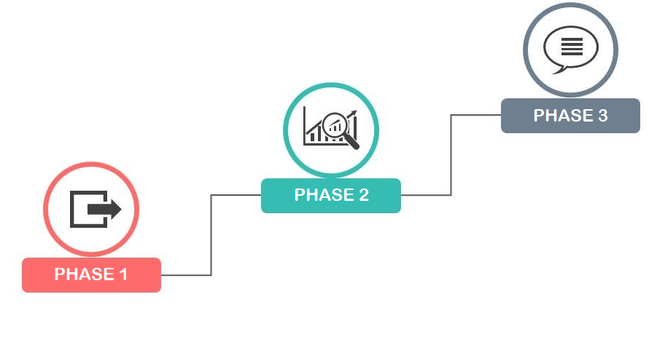
Phased Evolution Plan – Option 1
Overseas launch, Integration with other apps
Restaurant appraisal & consumer rating
SOP standardization & master training
Horizontal expansion of broadcasting
Multi-tier membership with range of features
Data science & analytics, Supply-chain services
Hospitality governance & administration solution
Sponsored Event Services, Corporate Tie-Ups
Pricing diversification, Integration with parallel trending apps
WAIŪ Hangout & personalized theme based offers & events
Confidential and Proprietary. Copyright (c) by TrueVibez 2020

Slide 16

Phased Evolution Plan – Option 2
Overseas launch, Integration with other apps
Restaurant appraisal & consumer rating
SOP standardization & master training
Horizontal expansion of broadcasting
Multi-tier membership with range of features
Data science & analytics, Supply-chain services
Hospitality governance & administration solution
Sponsored Event Services, Corporate Tie-Ups
Pricing diversification, External app integration
WAIŪ Hangout & personalized offers & events
Confidential and Proprietary. Copyright (c) by TrueVibez 2020
16

Slide 17
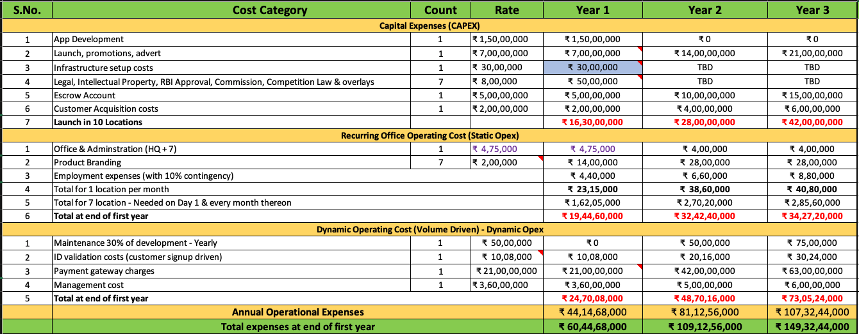
Capital Investment & Operational Expenditure

Slide 18
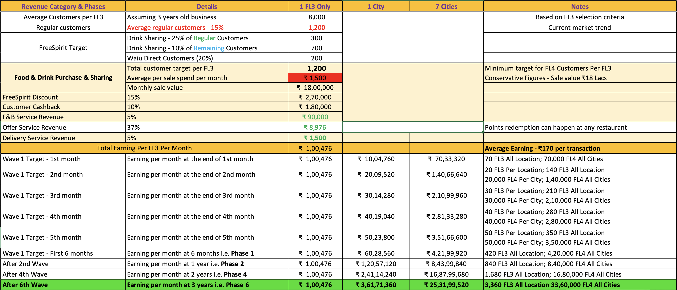
Revenue Model

Slide 19
Our Team – In-Progress
Rajesh Karandikar – Owner, 24k Restaurant Network
Alok Sambuddha – Director, American Express
Sanjay Kelapure – Hospitality Network Management
Shrikant Chatur – Governance Consultant
Shrikant Chepe – Technical Architect
Raju patil – Gaming Integration
Rahul Patil – Security Specialist
Chetan Oswal – Accountancy & counsel
Partners:
IRSRD – Development, Governance, Technical Consultant, HR
KPMG – IPA, RBI, PM
Sazinga – Current Development Partner (Discussions ongoing with prominent vendors)

Slide 20







Organization Structure
Rajesh Karandikar
Founder
Alok Sambuddha
Founder
Board Member 3
TBD
Board Member 4
TBD
Board Member 5
TBD
Board Member 6
TBD
Board Member 7
TBD
Account
Dept. Head
HR
Dept. Head
Legal/Compliance
Dept. Head
Sales
Dept. Head
IT
Dept. Head
Support
Dept. Head
Admin
Dept. Head
REGIONAL SALES OFFICES
Confidential and Proprietary. Copyright (c) by TrueVibez 2020
20

Slide 21






Question & Answers

Slide 22
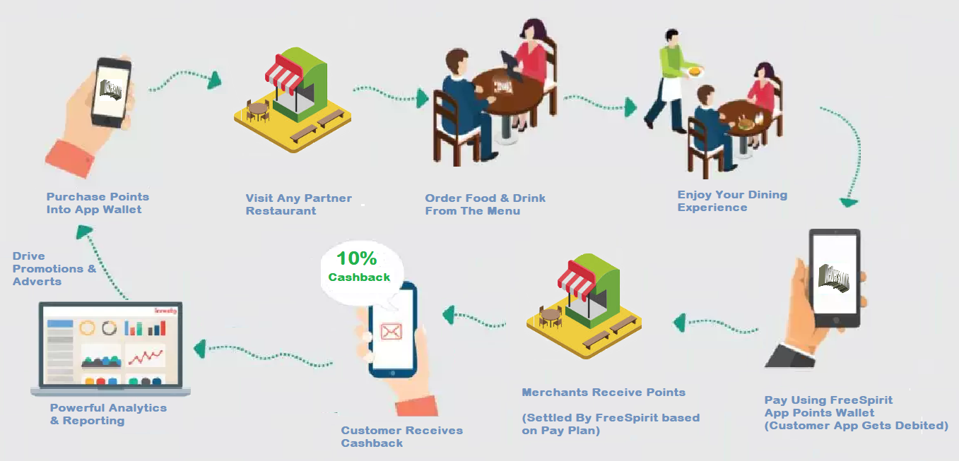
Appendix 1: Indicative Process Flow – Purchase

Slide 23
Action items
Customer acquisition plan – what is kind of payment we will need to spend? – 10 Rs per download and 20 Rs after a month
Restaurant acquisition plan – same as above
Customer retention strategy?
Waiu events
First drink free on app download at restaurant?
Restaurant owner event in location

